Slide 1
SQL CAPSTONE - 1
A.Sai Akhilesh

Slide 2
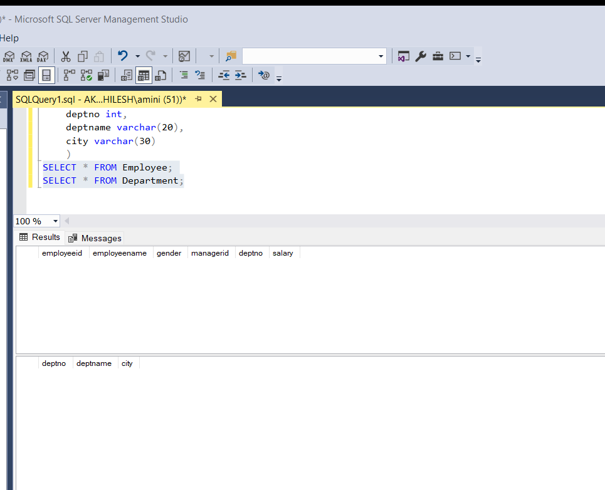
Q1: Create Table Employee with 6 columns that is
employeeid ,employeename,gender,managerid,salary,deptno.
Create table department with 3 columns deptno, deptname,city.
Here choose the appropriate datatype.
Ans:
CREATE TABLE Employee
(
employeeid int,
employeename varchar(30),
gender varchar(6),
managerid int,
deptno int,
salary int
)
CREATE TABLE Department
(
deptno int,
deptname varchar(20),
city varchar(30)
)
SELECT * FROM Employee;
SELECT * FROM Department;

Slide 3
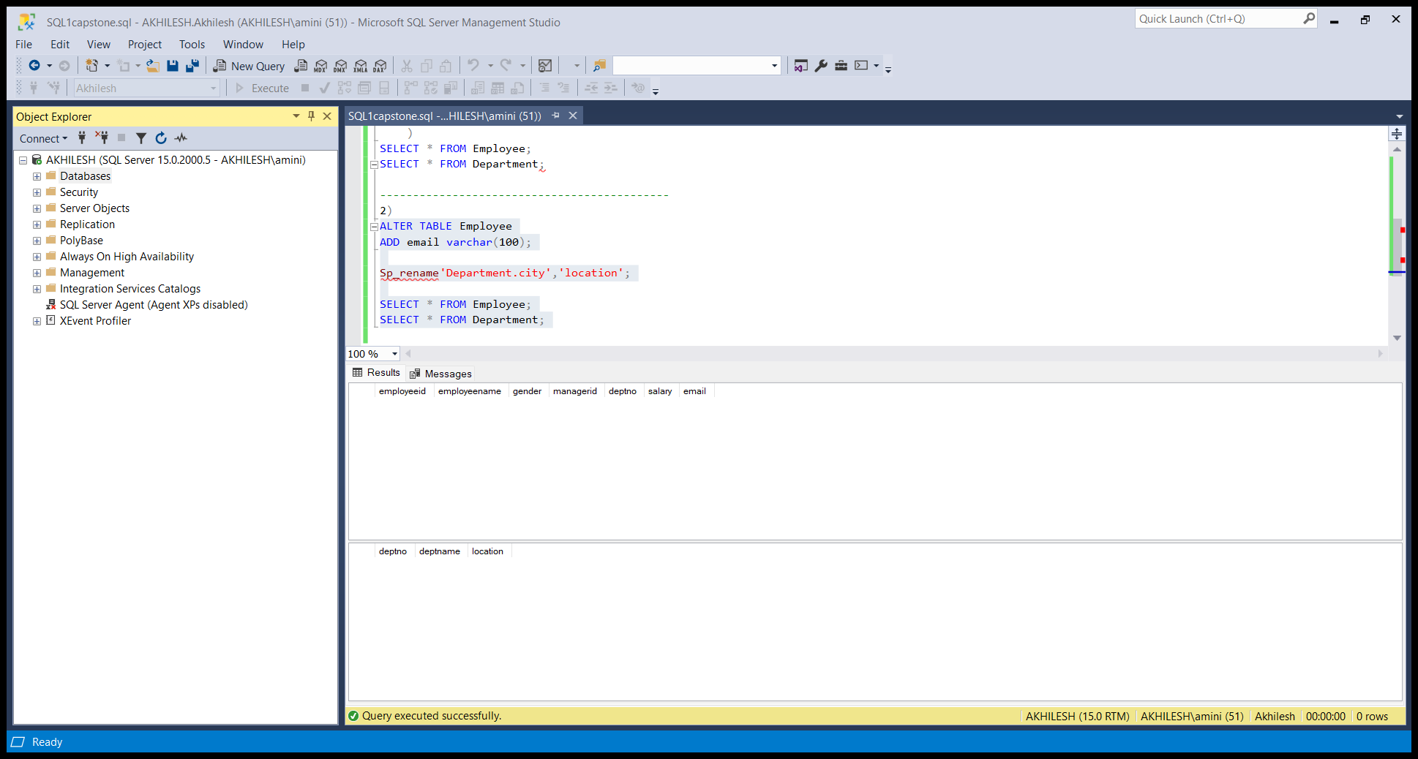
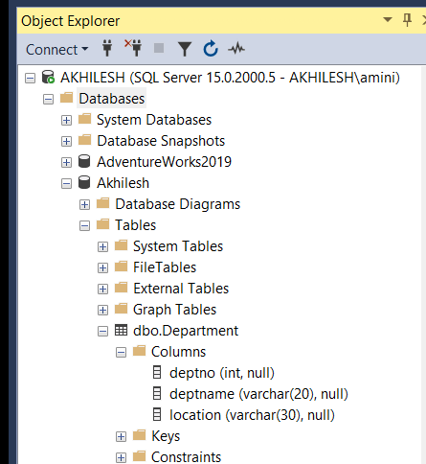
Q2: add email column in employee table, and change column name city to location in department table.
Ans:
ALTER TABLE Employee
ADD email varchar(50);
Sp_rename'Department.city','location';
SELECT * FROM Employee;
SELECT * FROM Department;
And we have another way to rename the column name with the help of object explorer.
Expand the databases select the database click on the tables
then select the table Department click on the columns then we get the columns in the department table ,right click on the city then select the rename option then we can rename the city to location.

Slide 4
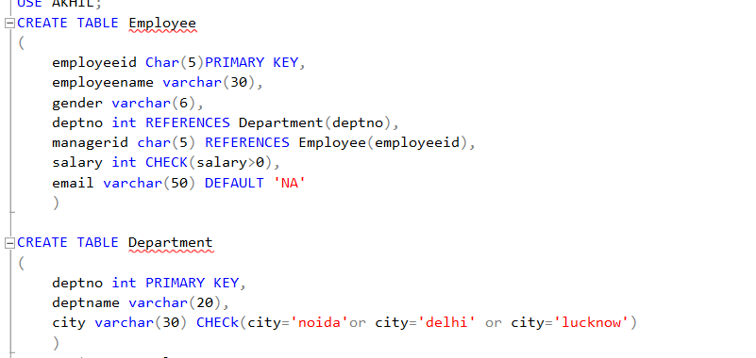
Q3: Add following constraints in employee and department table:-
● add primary key to employeeid
● add primary key to department table in department table.
● Add foreign key to deptno in employee table referencing deptno in department table.
● Add foreign key to manager id in employee table referencing employeeid
● Add default constraint to email column where default value is ‘na’.
● Add check constraint to city column that, city can be from Noida,delhi and lucknow
only.
● Add check constraint to salary column, that non negative salary value are not possible.
Ans:
ALTER TABLE Employee
ADD CONSTRAINT PK_employeeid UNIQUE(employeeid);
ALTER TABLE Department
ADD CONSTRAINT PK_deptno UNIQUE(deptno);
ALTER TABLE Employee
ADD CONSTRAINT FK_deptno FOREIGN KEY(deptno)
REFERENCES Department(deptno);
ALTER TABLE Employee
ADD CONSTRAINT FK_managerid FOREIGN KEY(managerid)
REFERENCES Employee(employeeid);
ALTER TABLE Employee
ADD CONSTRAINT DEFMAIL DEFAULT 'na’
FOR email;
ALTER TABLE Department
ADD CONSTRAINT CK_city CHECK (location in('Noida','delhi','locknow'));
ALTER TABLE Employee
ADD CONSTRAINT CK_sal CHECK (salary>0);
Here another way to add constraints to the columns directly while creating table this is very easy and doesn’t have any syntaxs for this

Slide 5
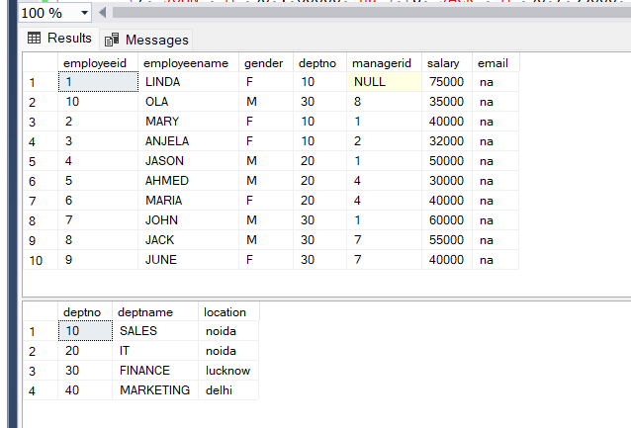
Q4: write insert command to insert the given data into both the tables.
Ans:
Insert the given the data by using insert command
INSERT INTO Employee
VALUES(1,'LINDA','F',10,null,75000,),(2,'MARY','F',10,1,40000),(3,'ANJELA','F',10,2,32000),(4,'JASON','M',20,1,50000),(5,'AHMED','M',20,4,30000),(6,'MARIA','F',20,4,40000),(7,'JOHN','M',30,1,60000),(8,'JACK','M',30,7,55000),(9,'JUNE','F',30,7,40000),(10,'OLA','M',30,8,35000);
INSERT INTO Department
VALUES(10,'SALES','noida'),(20,'IT','noida'),(30,'FINANCE','lucknow'),(40,'MARKETING','delhi');

Slide 6
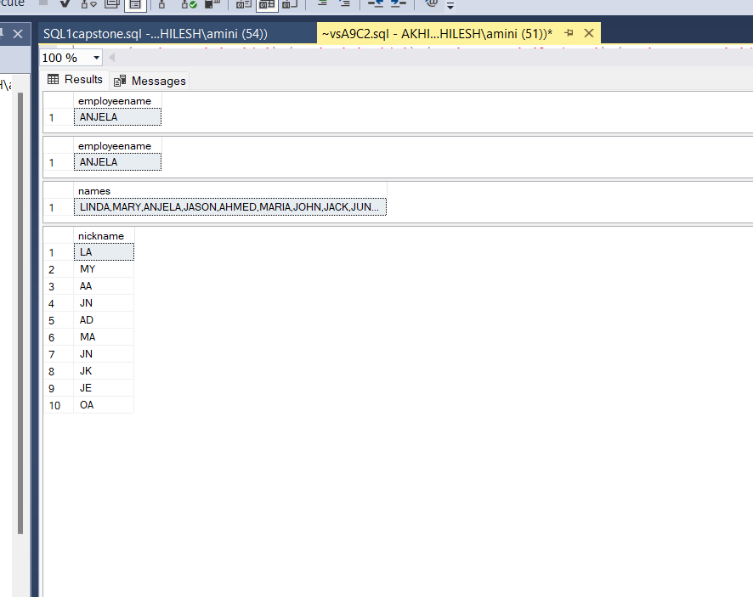
Q5: Write query for following result:
● to get the employees where first and last character of their name are same.
● Find employees where the length of name is greater then the length of employee where eid=5.
● In the output get all the neame in one row sepearting by comma.
For ex:- abc,bcd,def,fgh…
● Find the nickname of all employee by putting first and last character of there name together.
For ex: linda= LA
Ans:
SELECT employeename
FROM EMPLOYEE
WHERE employeename like 'a%a';
--select len(employeename) from Employee where employeeid = 5 -----
SELECT employeename
FROM Employee
WHERE LEN(employeename)>5
select string_agg(employeename,',') as names
from Employee
select concat(left(employeename,1),right(employeename,1)) as nickname
from employee

Slide 7
Q6: write queries to get the following reults:
A: find the count of employee who works in lucknow location.
B: find the total salary of employees for each deptno.
C: Find the least and maximum salried employee for each department.
D: what is the total salary for male and female employee.
E: how many employee get the salary greater then the average salary of marketing department.
F: which department have more number of employees then the employees in finance department.

Slide 8
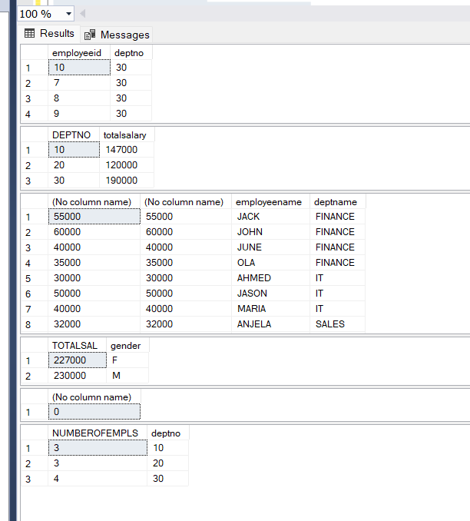
Ans:
SELECT Employee.employeeid,department.deptno
FROM Employee
INNER JOIN Department
ON Employee.deptno=Department.deptno
WHERE location='lucknow’;
Count of employee working in lucknow is 4.
SELECT DEPTNO,SUM(salary) as totalsalary
FROM Employee
GROUP BY deptno;
SELECT MAX(SALARY),MIN(SALARY),employeename,deptname
FROM Employee
INNER JOIN Department
ON Employee.deptno=Department.deptno
GROUP BY employeename,deptname;
SELECT SUM(SALARY)AS TOTALSAL,gender
FROM Employee
GROUP BY gender;
SELECT COUNT(EMPLOYEEID) FROM Employee
WHERE salary>(select avg(salary) from Employee
where deptno=40)
SELECT COUNT(EMPLOYEEID)as NUMBEROFEMPLS,deptno FROM Employee
GROUP BY deptno;
Finance department have more employees comparing to other departments.

Slide 9
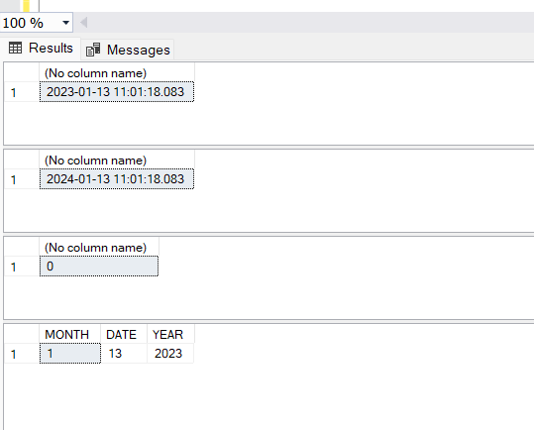
Q7: what are the date function you know?
Ans: In SQL we have the some functions like
GETDATE( ) : It returns the current date
SELECT GETDATE( );
DATEADD( ): It adds or subtracts for a specified time of interval
SELECT DATEADD(YEAR,1,GETDATE());
DATEDIFF : It returns the difference between the specified condition
SELECT DATEDIFF(MONTH,2015-12-13,2020-12-13);
MONTH,DATE,YEAR:It returns the month,day,year
SELECT MONTH(GETDATE())AS MONTH,DAY(GETDATE())AS DATE,YEAR(GETDATE())AS YEAR;
DATEPART , CONVERT , FORMAT are also the date functions.

Slide 10
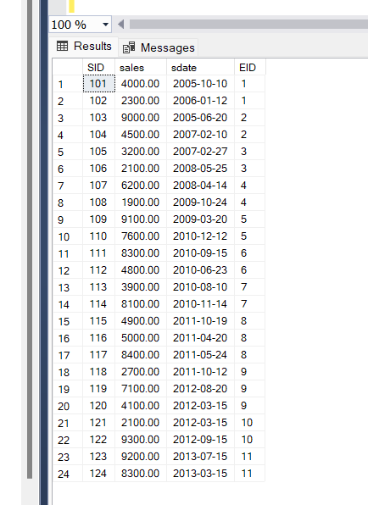
Q8: create table Sales(SID int primary key,sales money,sdate date,EID int)
After table is created, add Primary key on SID and foreign key on EID. This EID should reference
Employee table primary key
Ans:
CREATE TABLE Sales
( SID char(5) PRIMARY KEY,
sales money,
sdate date,
EID char(5) REFERENCES Employee(employeeid)
)
INSERT INTO Sales
VALUES(101,4000,'2005-10-10',1),(102,2300,'2006-01-12',1),(103,9000,'2005-06-20',2),(104,4500,'2007-02-10',2),(105,3200,'2007-02-27',3),
(106,2100,'2008-05-25',3),(107,6200,'2008-04-14',4),(108,1900,'2009-10-24',4),(109,9100,'2009-03-20',5),(110,7600,'2010-12-12',5),
(111,8300,'2010-09-15',6),(112,4800,'2010-06-23',6),(113,3900,'2010-08-10',7),(114,8100,'2010-11-14',7),(115,4900,'2011-10-19',8),
(116,5000,'2011-04-20',8),(117,8400,'2011-05-24',8),(118,2700,'2011-10-12',9),(119,7100,'2012-08-20',9),(120,4100,'2012-03-15',9),
(121,2100,'2012-03-15',10),(122,9300,'2012-09-15',10),(123,9200,'2013-07-15',11),(124,8300,'2013-03-15',11)

Slide 11
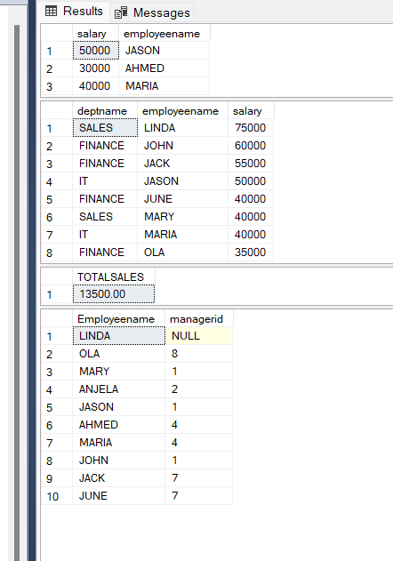
Q9:
a. Display dname,ename,salary for top 2 employees salary wise only for IT department. Use ranking
function
b. Display top 2 salaried employees from every department. Show Dname, Ename and Salary
c. Display the department name and total sales done by those department.
d.Display the name and sales for those employees who do sales in October
e. Display the name and manager name of all the employees including the name of Top level employee
SELECT Department.deptno,salary,employeename
From Employee
INNER JOIN Department
ON Department.deptno=Employee.deptno
order by salary DESC
WHERE deptno=20;
SELECT Department.deptname,employeename,salary
FROM Employee
INNER JOIN Department
ON Department.deptno=Employee.deptno
order by salary desc
SELECT SUM(sales)AS TOTALSALES
FROM Sales
WHERE MONTH(sdate) = 10
SELECT Employeename,managerid
from Employee

Slide 12
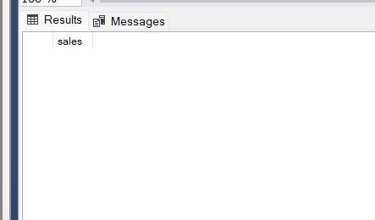
Q10:
a. Find employees who have not done any sales.
b. Find employee who have done more number of sales then the employee who have done 2 nd
maximum total sale out of all employees.
Ans:
SELECT Employee.employeename,sales
FROM Sales
INNER JOIN Sales
ON Employee.employeeid=Sales.EID
WHERE Sales=0
All employees done the sales there is no employee not done any sales
select Employee.employeeid,sales
from Sales
inner join Employee
on Employee.employeeid=Sales.EID

Slide 13
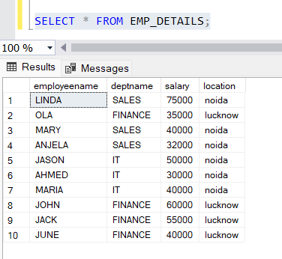
Q11: create view so that column included are employeename,deptname,salary,location. This view
should be schemabinded and encrypted.
Ans:
CREATE VIEW EMP_DETAILS
AS
SELECT Employee.employeename,deptname,salary,location
from Department
INNER JOIN Employee
ON Employee.deptno=Department.deptno
SELECT * FROM EMP_DETAILS;

Slide 14
T
H
A
N
K
Y
O
U

